Slide 1
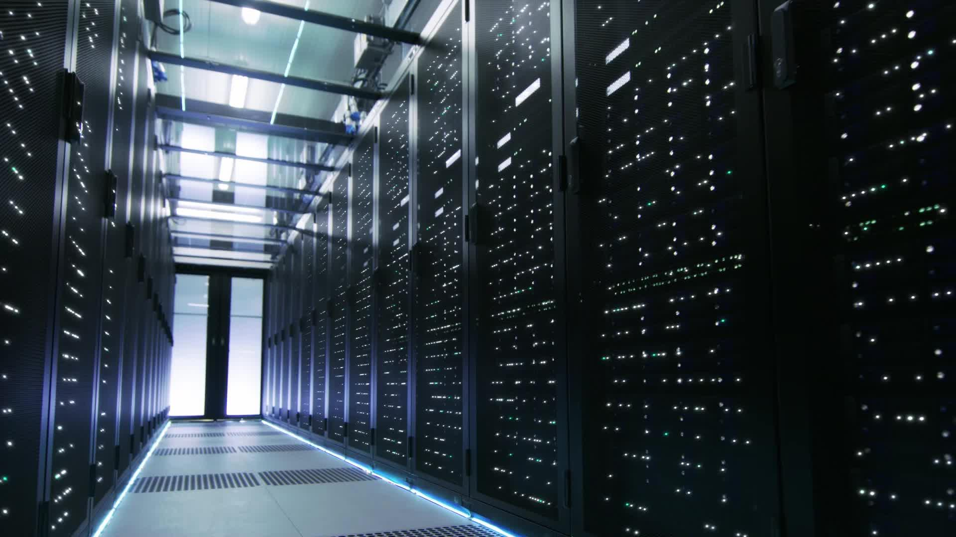
GPU power variability in ML Systems

Slide 2
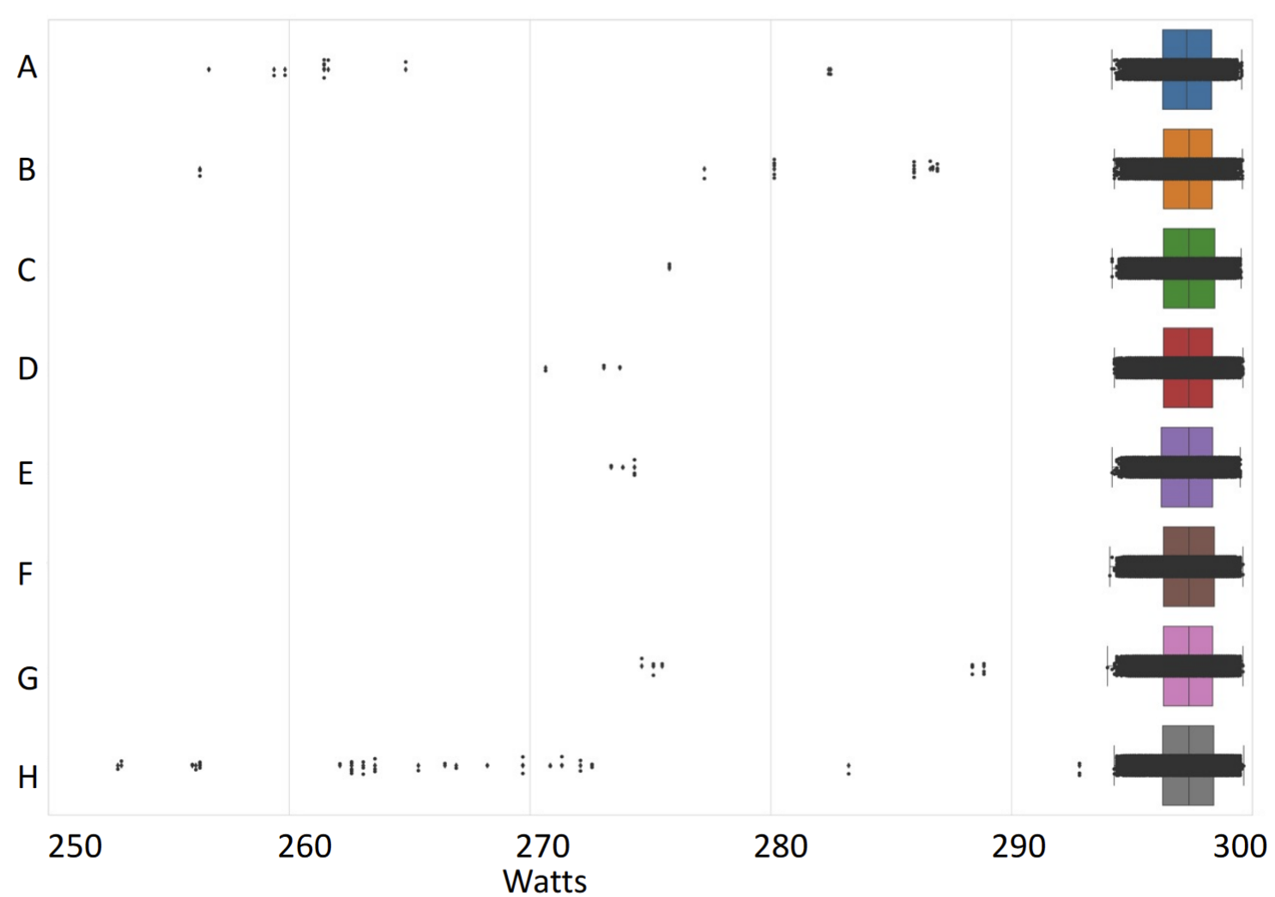
Notes:
Source: Performance Heterogeneity in High Performance GPUs. A Guliani et. al.

Slide 3
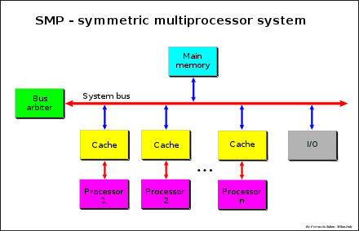
Prior Work
Focus mainly on CPUs
Studies often at device level rather than system level
Proposed solutions assume symmetry in operation of all participating nodes
unlike real world systems
Notes:
[a] R. Nath, D. Tullsen, Chapter 18 - Accurately modeling GPGPU frequency scaling with the CRISP performance model, In Emerging Trends in Computer Science and Applied Computing, Advances in GPU Research and Practice
Image credits - https://upload.wikimedia.org/wikipedia/commons/thumb/1/1c/SMP_-_Symmetric_Multiprocessor_System.svg/880px-SMP_-_Symmetric_Multiprocessor_System.svg.png

Slide 4
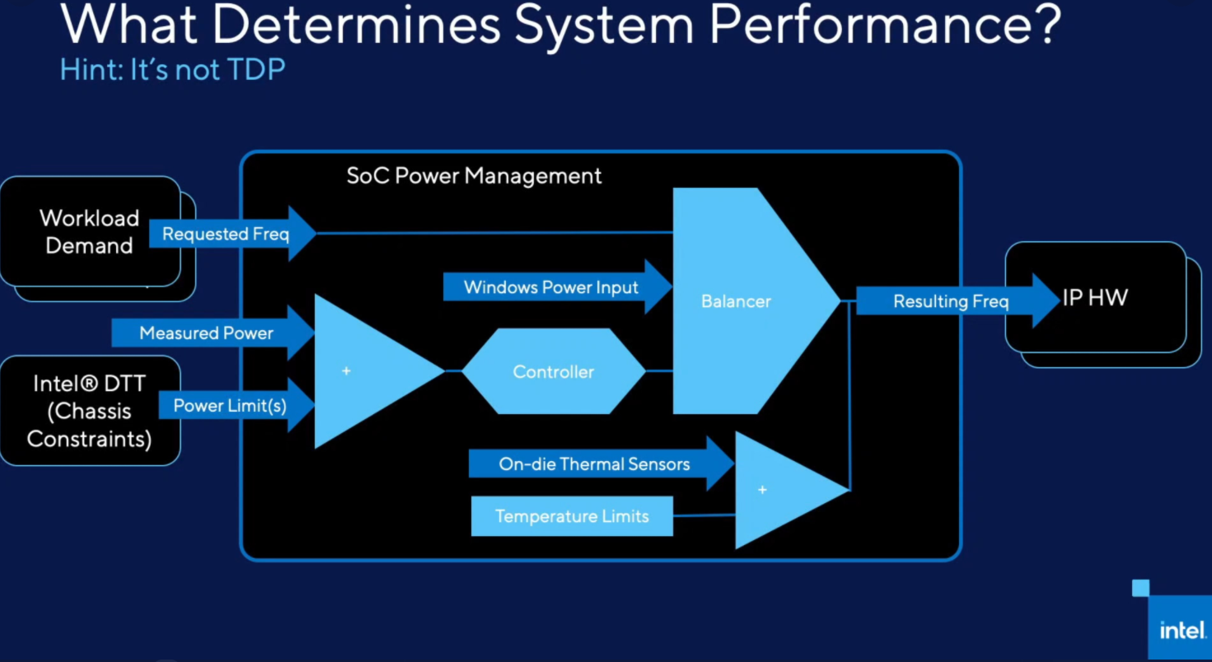
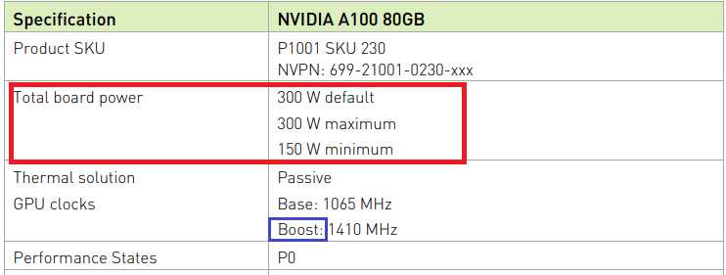
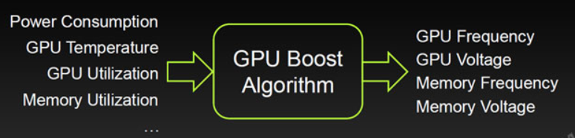
Plan (Profiling, Characterization, Mitigation)
Identify measurable factors that affect variability at device level
Notes:
Like Ashwin mentioned, variability gets worse with scale which is concerning for massively parallel workloads
We plan to approach this in 3 steps
The first one is profiling at the device level to identify measurable factors that can impact variability. This is important because a lot of detail on dvfs, and variability is usually hidden in fine print.
https://www.nvidia.com/content/dam/en-zz/Solutions/Data-Center/a100/pdf/PB-10577-001_v02.pdf
https://twitter.com/Krewell/status/1301226753701027843/photo/1
https://www.intel.com/content/www/us/en/support/articles/000055611/processors.html

Slide 5
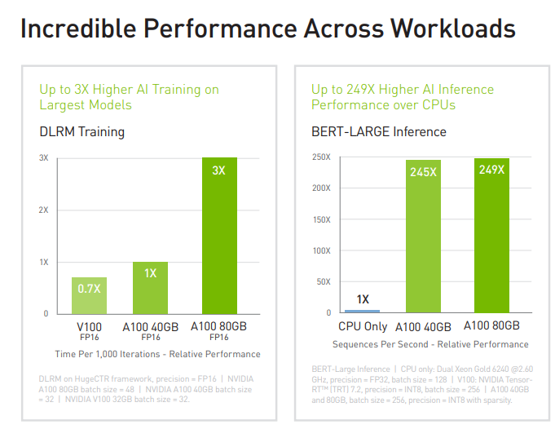
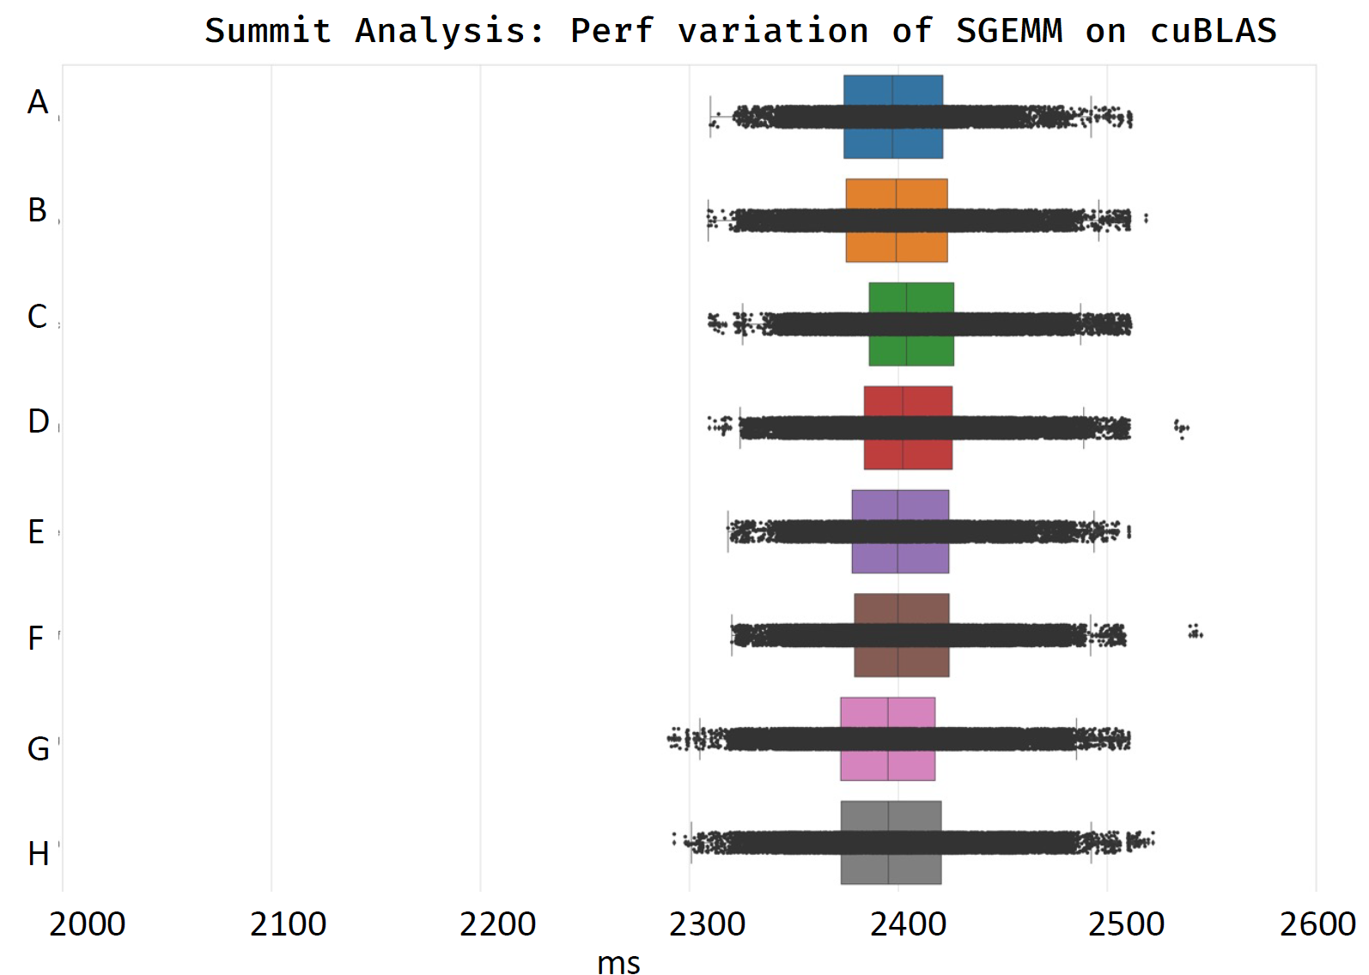
Plan (Profiling, Characterization, Mitigation)
2. Characterization of ML [Systems + Workloads]
Benchmark numbers today do not account for variations
Systems characterization for variation that covers:
Applications: Training, Inference
Bottlenecks: Compute, Memory
Configurations: Multi-GPU over NVLink to warehouse-scale systems
Notes:
Like we see here for the a100 GPU power is shown as a constant but it almost never is and it makes performance unpredictable. So as an example that there's more to system perfomance than just TDP, this shows the control state logic for an Intel CPU here and similarly factors that affect boost on a GPU. Once we've identified the factors, we want to characterize workloads that exhibit these variations. Benchmarks today don't account for them. To fundamentally understand variations by correlation we want to cover something we call the ABC's of characterization to include applications, bottlenecks and system configuration.
Source: Nvidia A100, Performance Heterogeneity in High Performance GPUs. A Guliani et. al.

Slide 6
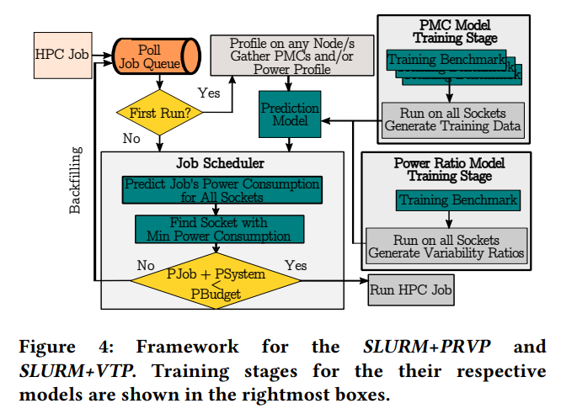
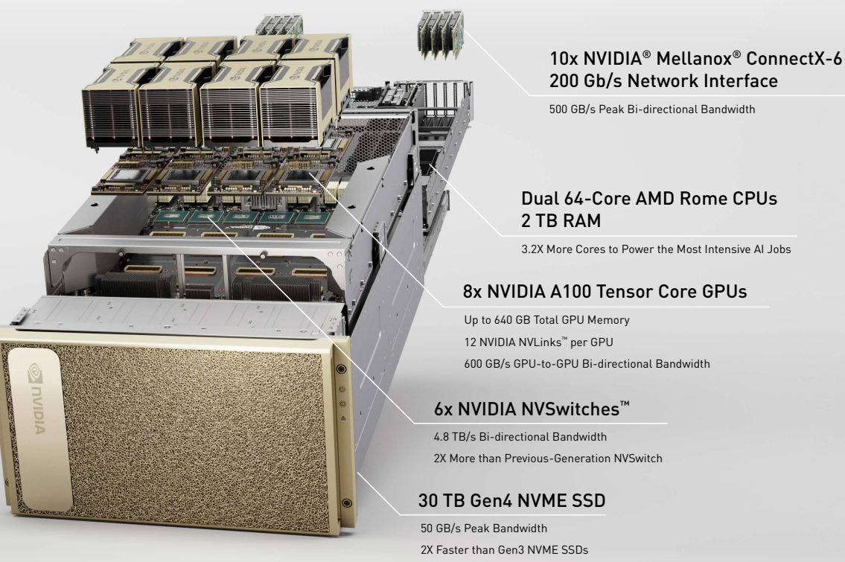
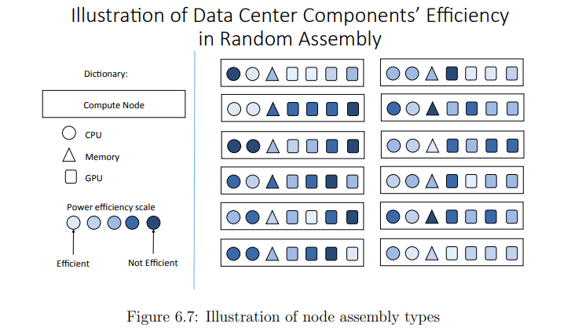
Plan (Profiling, Characterization, Mitigation)
3. Investigate variability mitigation at the systems-level
Notes:
From previous work, we think that there are two ways to deal with variability. One is a variability aware scheduling that minizes the effect of variations by considering factors we discussed earlier. The other one is interesting because the variations we've been talking about can also affect neighboring GPUs. Here we see a single node of DGX that is clearly packed to the brim and this is where variability guidance for spatial effects maybe useful.
http://charm.cs.illinois.edu/newPapers/18-06/thesis.pdf
https://images.nvidia.com/aem-dam/Solutions/Data-Center/nvidia-dgx-a100-infographic.pdf
https://dl.acm.org/doi/pdf/10.1145/3330345.3330372

Slide 7
Expected output
Profiling
Analysis model for variability and defined assumptions
Gather documented insights into Boost/DVFS
Characterization
Defining a stressmarkª suite for ML workloads that demonstrate variability
Mitigation
Feasibility study of variability-aware scheduler/spatial assembly
Notes:
[a] https://ieeexplore.ieee.org/abstract/document/5993645

